Slide 1

Stage 6 Careful, He’s a Hero Course Designer: Jordan Rogers
Careful, He’s a Hero is a 16 round, 80 point Virginia Count Medium course. There are 8 USPSA targets. The best two hits per target will score. The start signal is audible.
The Handgun start position is standing with toes touching marks and wrists above shoulders. Handgun is loaded and holstered. The PCC start position is standing with toes touching marks with PCC loaded, safety on, stock on belt.
On the audible start signal, engage targets as visible within the shooting areas with ONLY two rounds each.

Slide 2
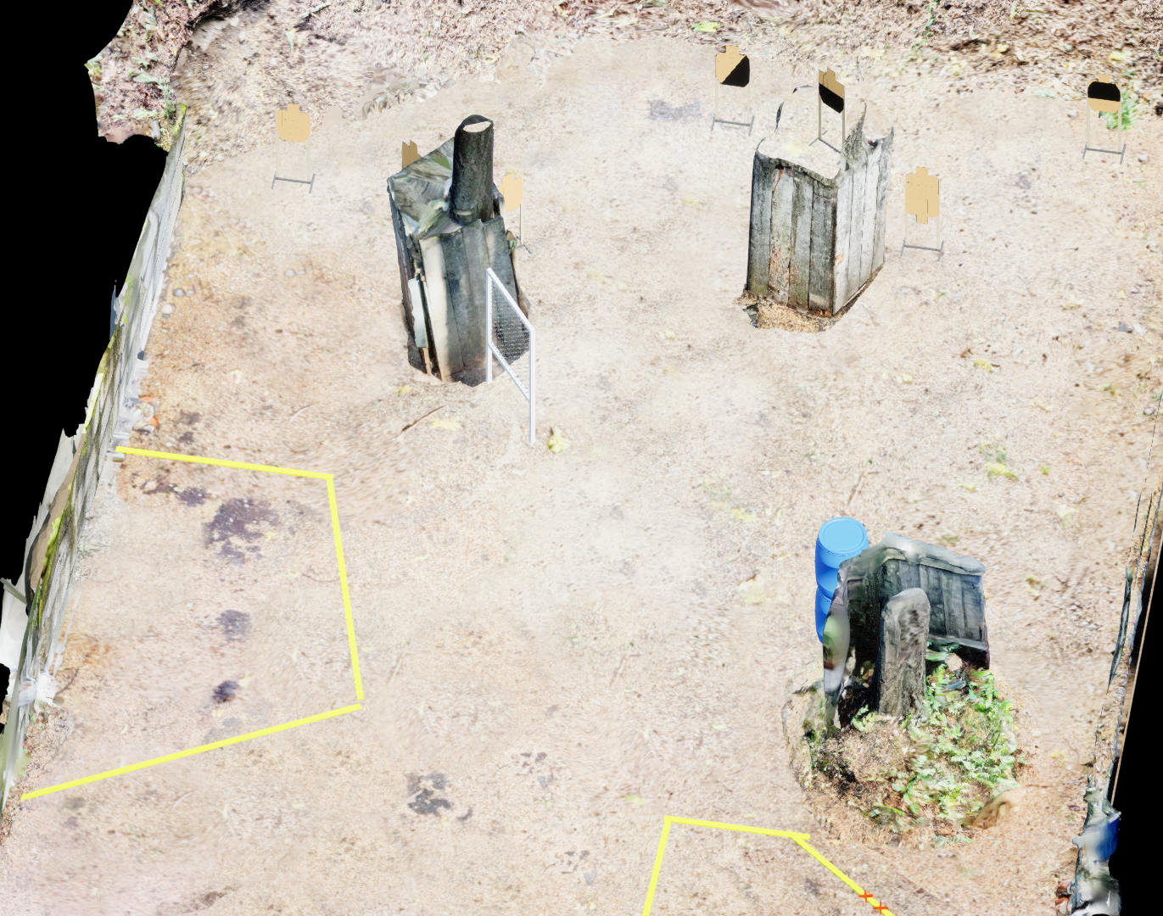
 | Stage 6 Careful, He’s a Hero Course Designer: Jordan Rogers

